Slide 1
Data Communication and Communication Networks
DCCN – CSC339
MyFTP
(Using File Transfer Protocols)
Group Members: Haseeb Ahmed Saeed
SP18-BCS-063/5B
Muhammad Ameen
SP18-BCS-098/5B

Slide 2
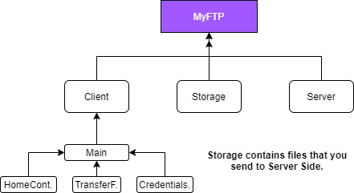
Client Side
The Client side of MyFTP Project is build inside JavaFX along with Java programming language.
Project Architecture

Slide 3
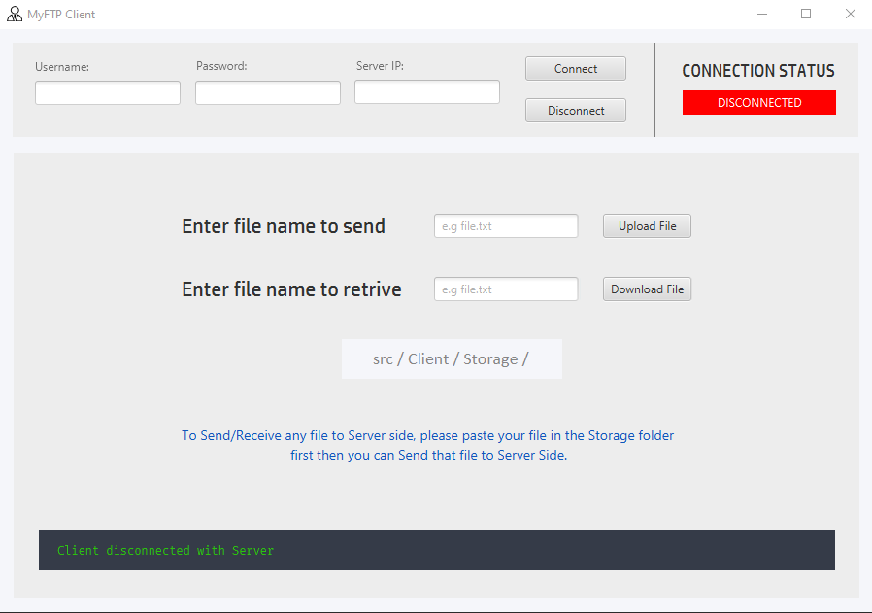
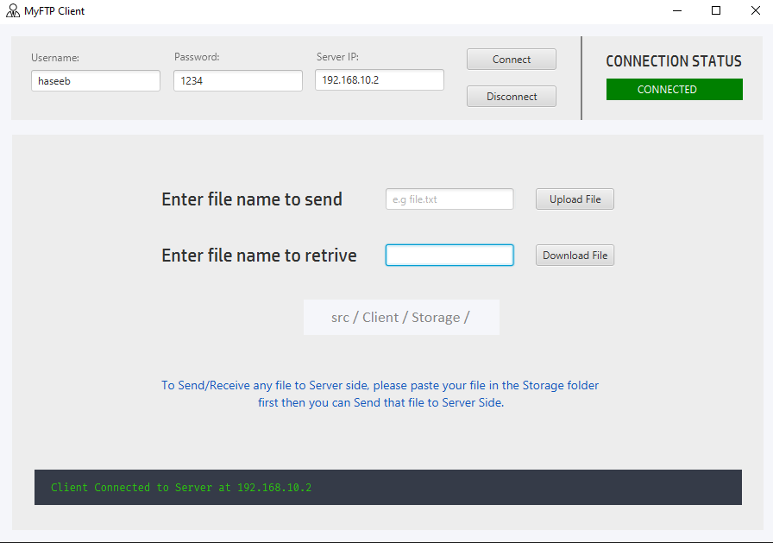
Client Side (src/Client/Main.java)
Server side is build with procedural approach thus making it as simple
to use as possible.
Screenshots:

Slide 4
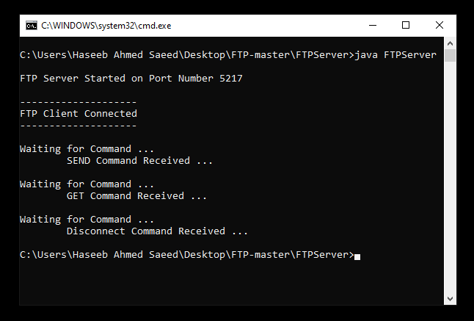
Server Side (src/Server/Server.java)
Screenshots:

Slide 5
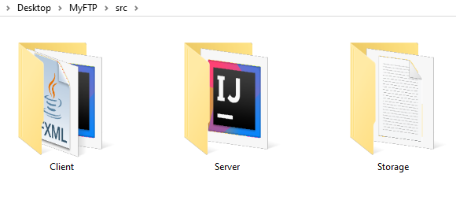
Storage (src/Storage)
This folder is restricted to be used when a Client wants to send his file to Receiver (Server Side).
A Client has to put his file/folder inside the Storage
Folder then only he be able to send the files to Server side.

